Slide 1



MASAI SCHOOL
remote job analysis
JOB SCRAPERS ANALYSING DATA
ROLES AND TRENDS
BY:
K S ROSHINI
WWW.REALLYGREATSITE.COM

Slide 2

PROJECT OVERWIEW
AND OBJECTIVE
Objective:
To analyze current trends in remote job opportunities by scraping data from a job listing website and generating insights using SQL and data visualization.
Remote jobs have grown rapidly since the pandemic.
Job seekers need clarity on which companies, roles, and locations offer the most remote opportunities.
Analyzing this data helps in making informed career choices.
WWW.REALLYGREATSITE.COM

Slide 3
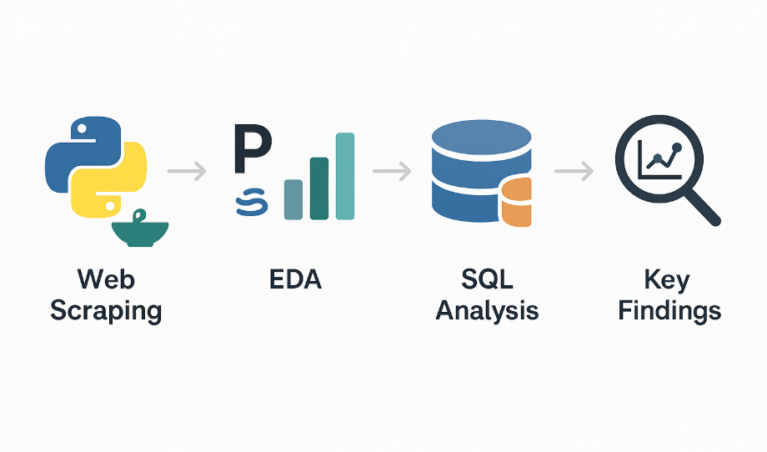

Slide 4

Tools for
Data Analysis
Web Scraping
EDA and Visualization
SQL Insights
Scraping job listings from a job board remoteok.com for remote jobs using the API and JSON
Performing EDA using pandas and required libraries
Visualizing the results for better understanding using the seaborn,matplot libraries
Analysing SQL and Generatinng insights using SQL queries
WWW.REALLYGREATSITE.COM

Slide 5
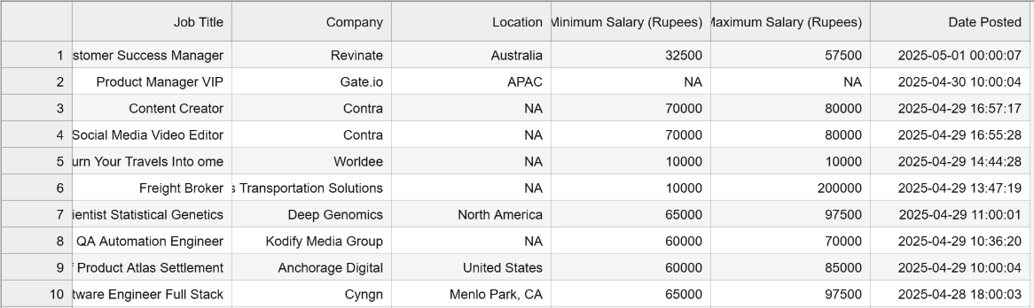

WEB SCRAPING
The URL (https://remoteok.com/api) is the API endpoint that provides job listings in JSON format.
The headers dictionary includes a User-Agent string to mimic a request from a web browser (useful to avoid being blocked by the server).
Response stores the HTTP response, which is in JSON (JavaScript Object Notation)format containing job listings.
The response.json() method converts the JSON response into a Python dictionary/list.
The response contains some metadata as the first element, so [1:] is used to skip this and extract the actual job listings.
The Extracted details is stored in the CSV format and the details are as follows

Slide 6
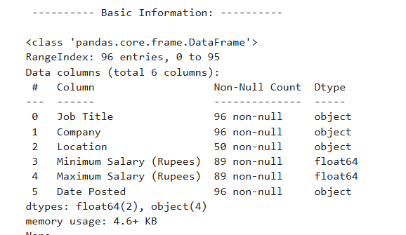
EXPLORATORY DATA ANALYSIS(EDA)
GOAL:
Performing EDA using pandas and required libraries.
Visualizing the results for better understanding using the Seaborn, Matplot libraries
1.UNDERSTANDING THE DATASET:
WWW.REALLYGREATSITE.COM

Slide 7
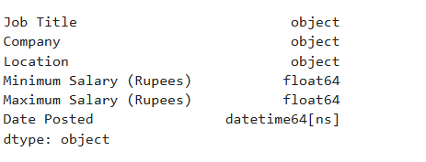
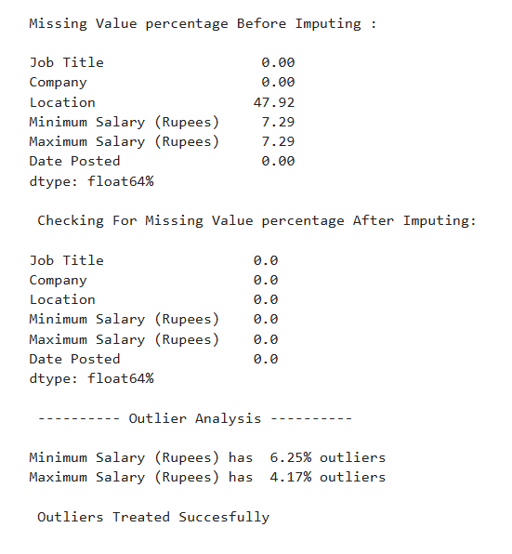
2.DATA CLEANING

Slide 8
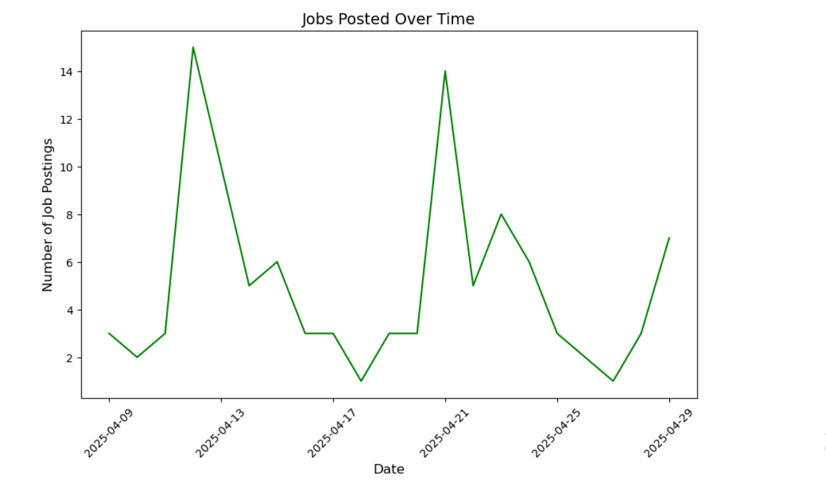
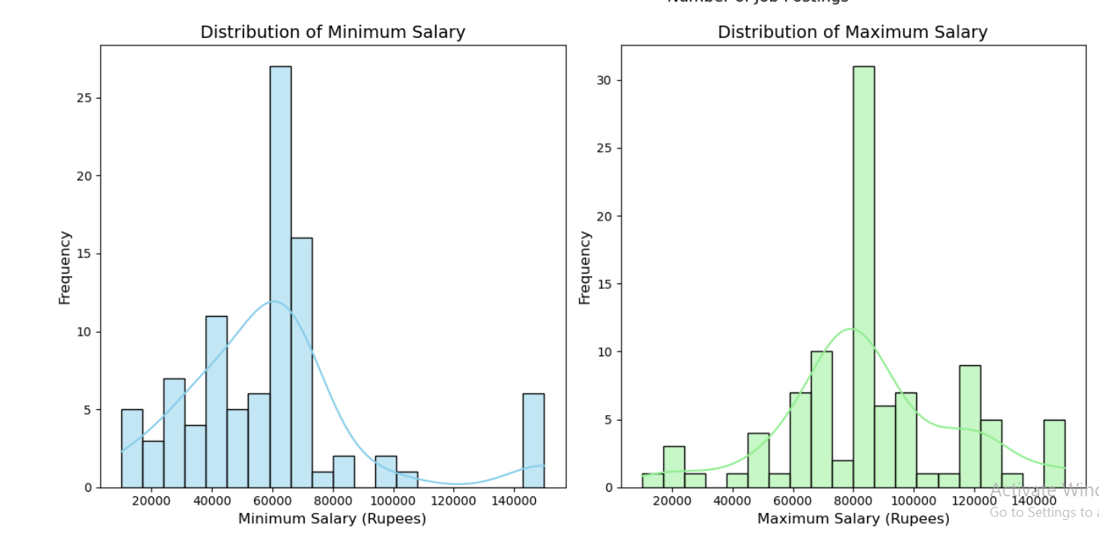
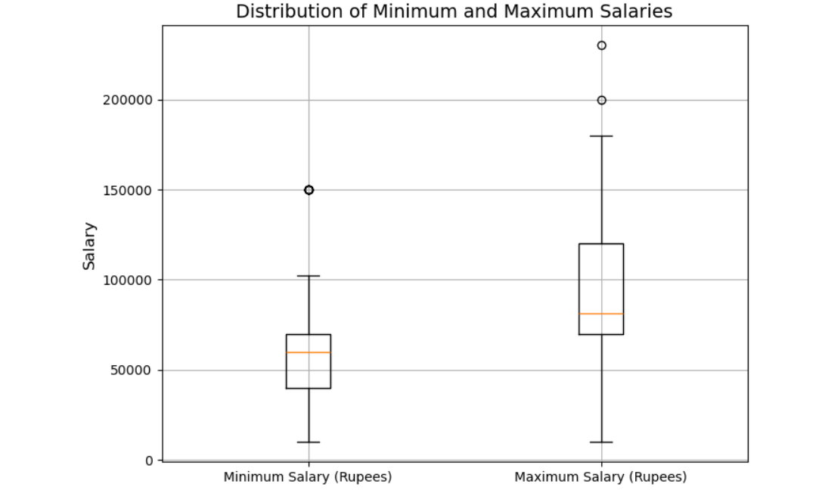
3.VISUALIZATIONS

Slide 9
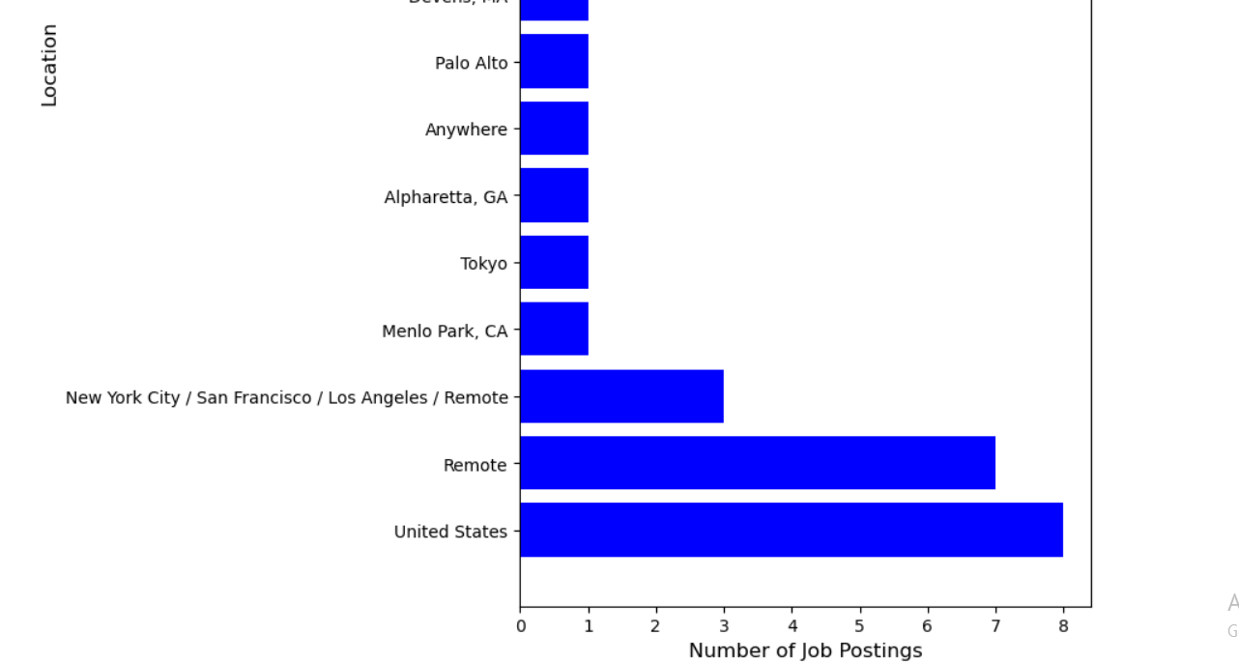
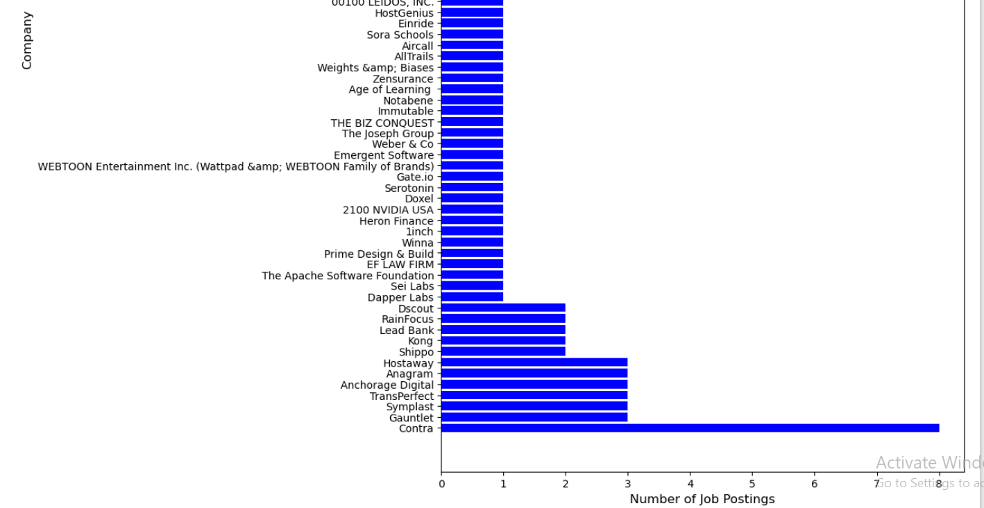

Slide 10
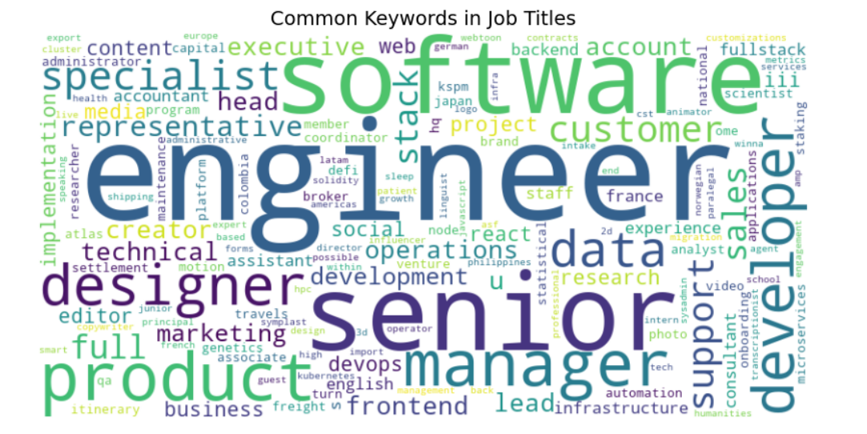
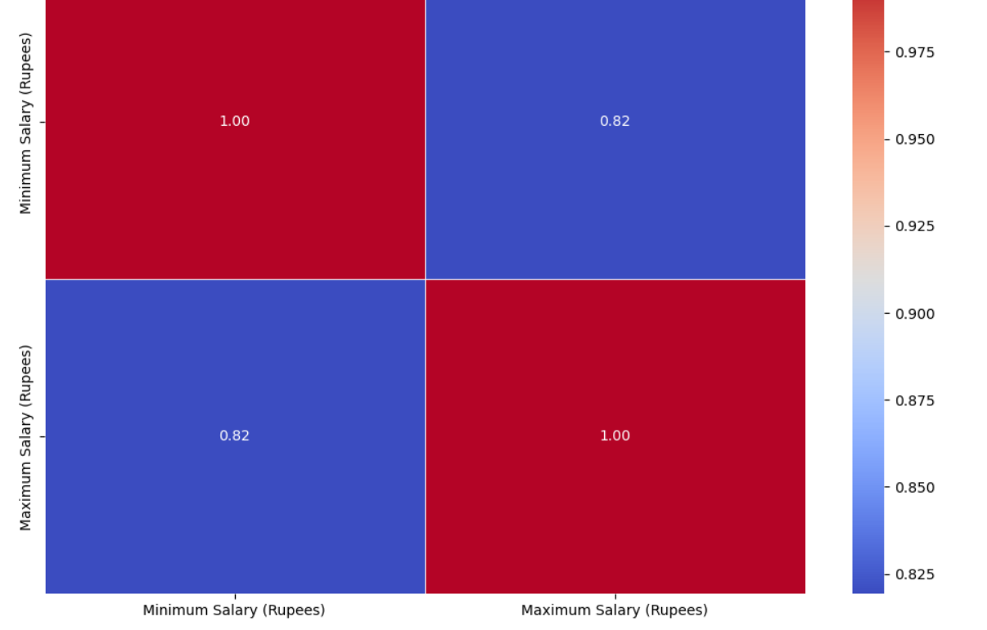

Slide 11
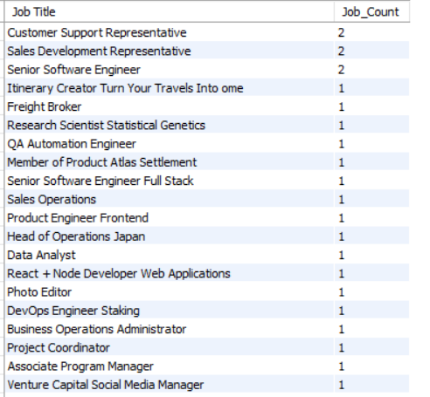
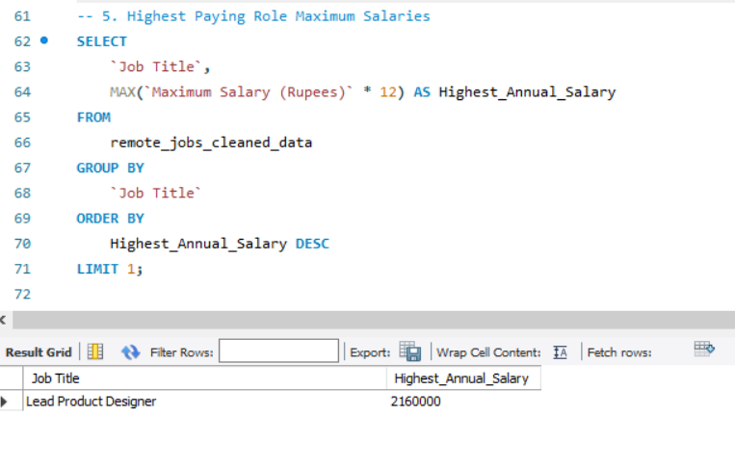
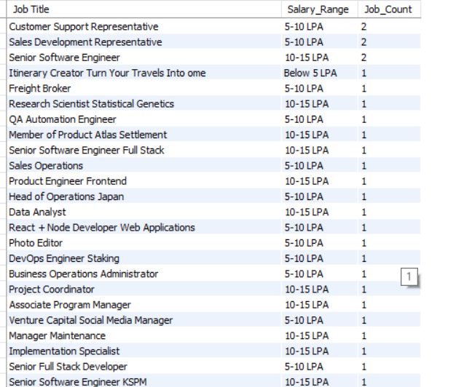
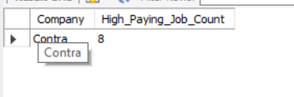
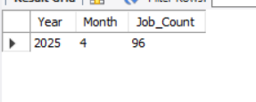
SQL INSIGHTS

Slide 12
OUTCOMES AND FINDINGS
In the 2025 there are total 96 Job Listings.
Most common Job Titles are Customer Support Representative, Sales Development Representative, Senior Software Engineer.
Highest Paying Company is 'Contra' and Lowest Paying Company is 'SlideSpeak AI‘.
Most Hiring Loctions are World Wide with the Highest and Unites States,Remote, reamining all as ranges from 1 to 3.

Slide 13
Jobs are posted consistently throughout April 2025.
Most jobs are marked “World Wide” or “Remote”, highlighting the trend of global.
Top Location of the companies Hiring is Unites States followed by Remote.
Minimum and Maximum Salary are strongly positively correlated (correlation = 0.84).
This means when minimum salary increases, maximum salary usually increases too.
MOST HIRING COMPANY AND HIGH PAYING COMPANY IS “CONTRA”.
LOWEST PAYING COMPANY IS “SLIDESPEAK AI”.
MOST HIRING LOCATION IS “US”.

Slide 14
thank
you!

